Slide 1

TUN Challenge
Group 10

Slide 2

Our Question
Is there a way to tell what communication method (call, texting, or email) is more successful with clients, either based on their success in job placement or some other outcome?

Slide 3

Summary
We analyzed the average amount of calls/email recruiters sent to clients
Determined the trends/patterns in active vs non-active Hire Heroes USA members

Slide 4

Problem and Motivation
Help find ways to motivate to assist future job seekers to secure jobs at a higher success rate.
College students can relate with said struggle.
Through data analytics, we can find a solution to help ourselves and to help others that are seeking jobs.
Data can reflect on the state of job hiring and the recruiting industry in the modern age.

Slide 5

Approach
Look through data dictionary to get a greater understanding
Used Sales Force Contact dataset, prioritized on columns:
ID, Ringdna100_email_attempts, Ringdna100_call_attempts, Client_C, Date_turned_blue_c, and Date_turned_green_c
Distinguished Donors vs Clients in Client_C sheet
Donor information was not required
People with dates next to their names in date_turned_blue_c column were hired
Date_turned_green_c sheet helped us determine the amount of active users on Hire Heroes USA
Hypothesis: Active users had a better chance of getting hired

Slide 6

Tools and Analytics
Used the data cleaning method through Excel.
Tried to find duplicates using conditional formatting.
Eliminated donors through the Client_C column.
Used data_turned_blue and data_turned_green columns to evaluate relationships between various factors and hiring rate
Implemented vlookup formula to determine call/email frequency per client

Slide 7
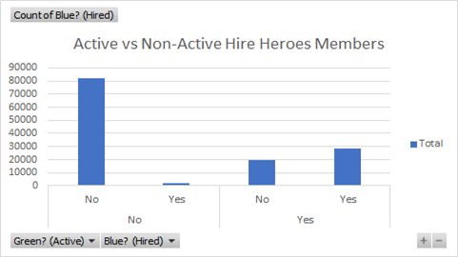
Results
Majority of non-active members were not hired
Majority of active members were hired
How to overcome?
Hire Heroes USA must find ways to help members maintain active status
Possibly implement new features or strategies
Non-Active
Active

Slide 8
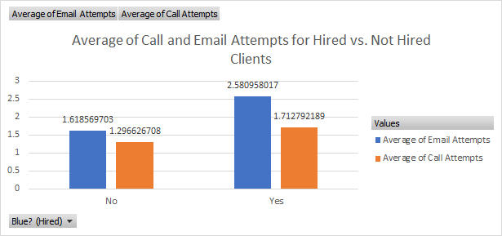
Results
On average, recruiters called and emailed hired clients more than non-hired clients
Recruiters may contact more qualified clients
Variable: Qualifications of clients
How to overcome?
Hire Heroes USA should post jobs from all different industries and experience levels
Not-Hired
Hired

Slide 9
References
https://www.hireheroesusa.org/

